Slide 1

Neural Substrates of Attention and Awareness
Dan Birman
Gardner Lab
Lightning Talks – 2015-04-23

Slide 2


Slide 3


Slide 5
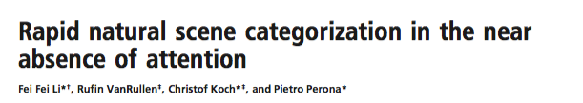

Slide 6
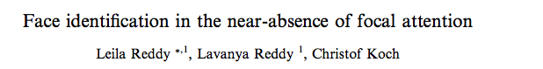

Slide 7
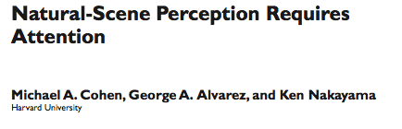

Slide 9
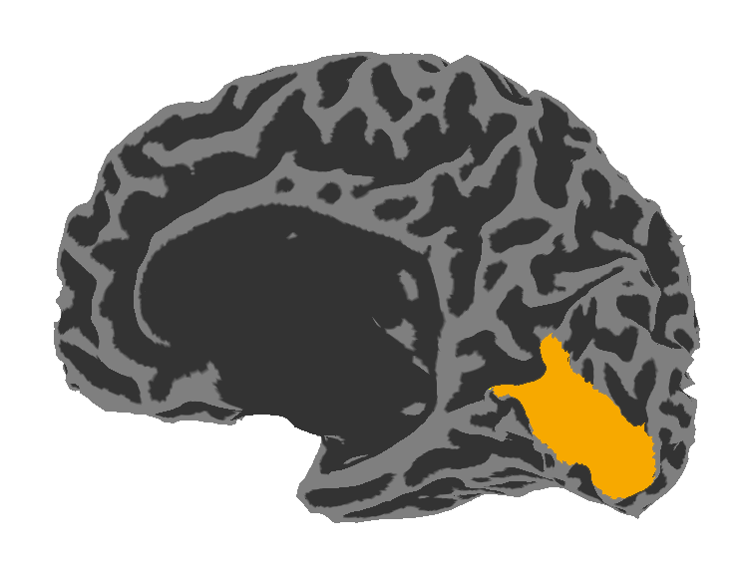
Visual Area V1:
Sensitive to Contrast

Slide 10
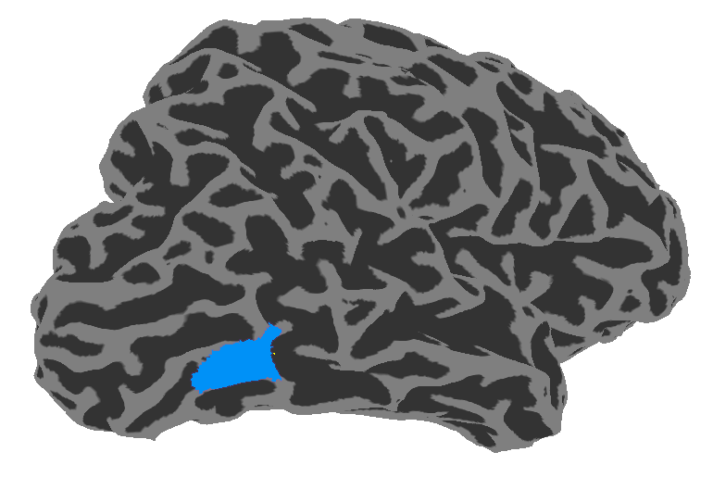
Visual Area V1:
Sensitive to Contrast
Visual Area hMT:
Sensitive to Motion Coherence

Slide 11
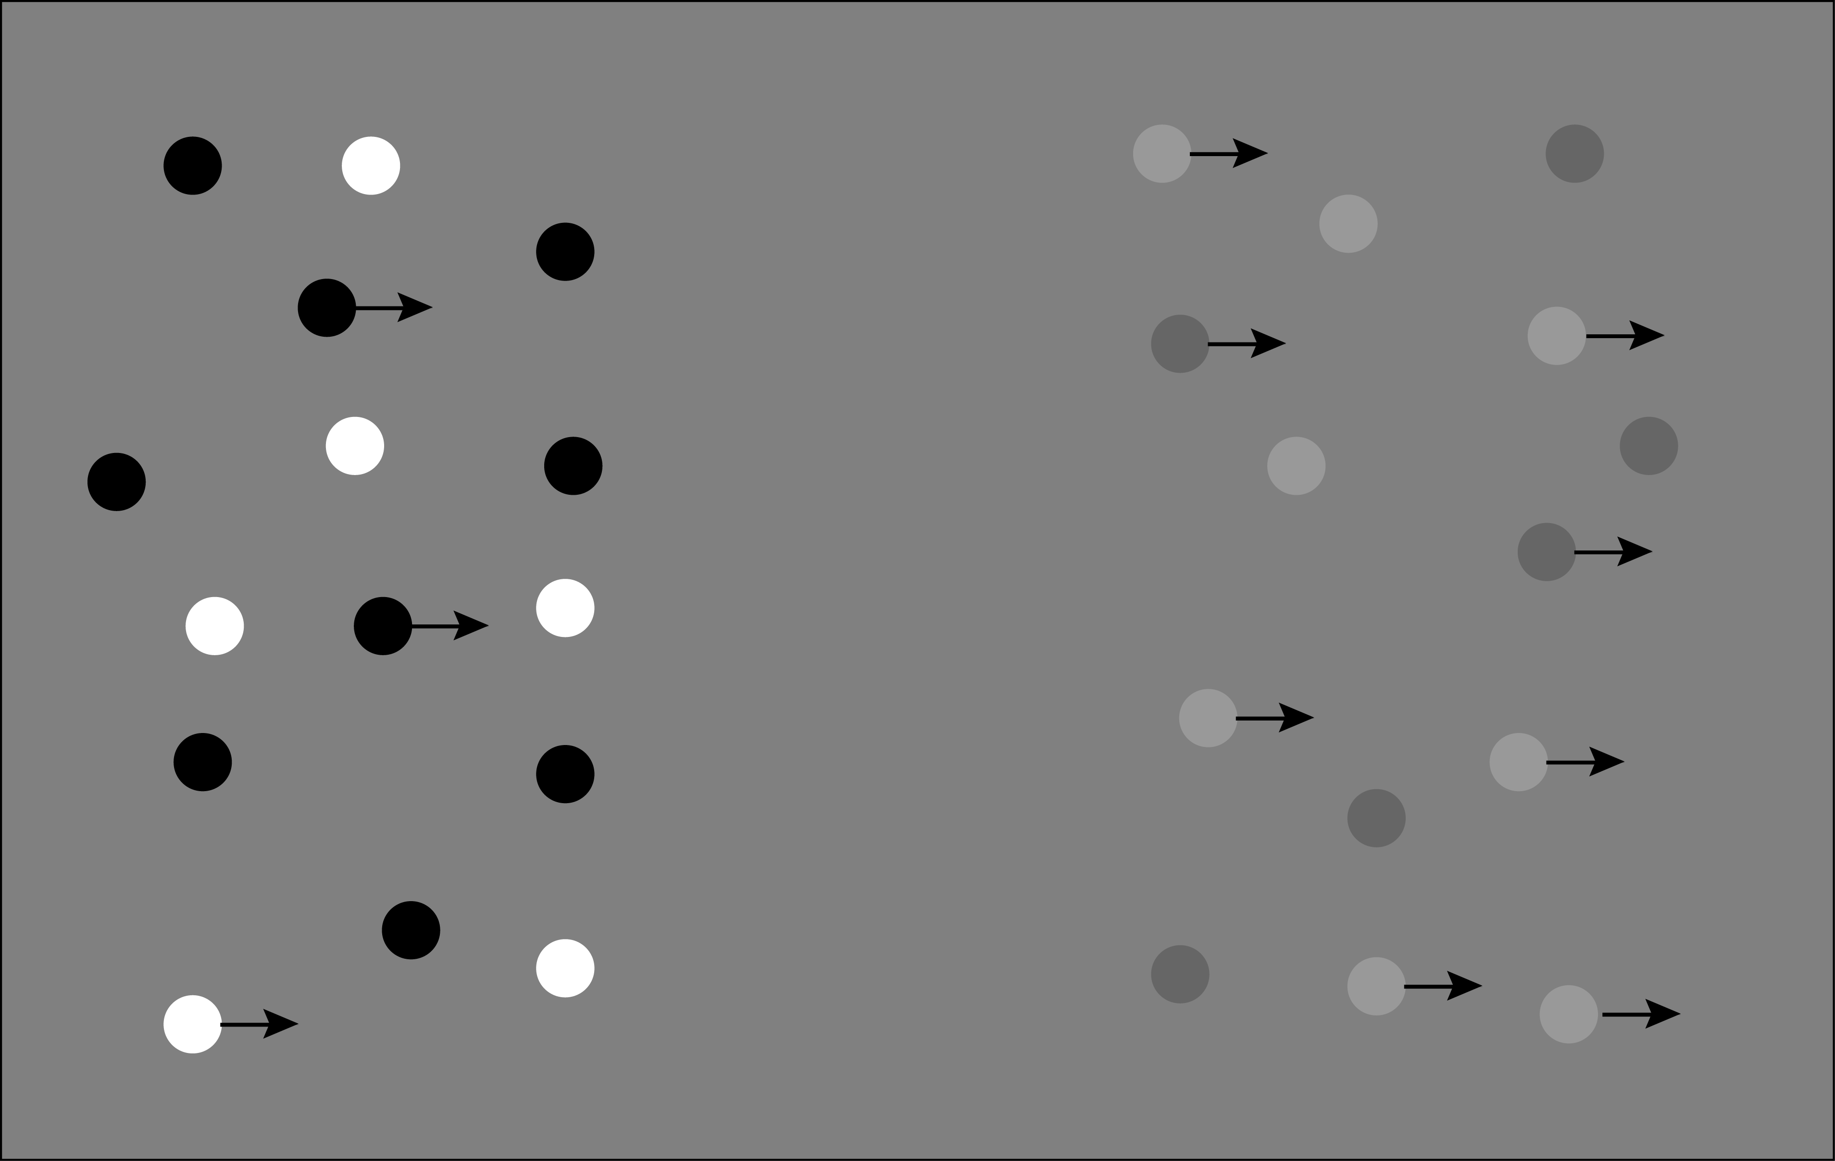

Slide 12
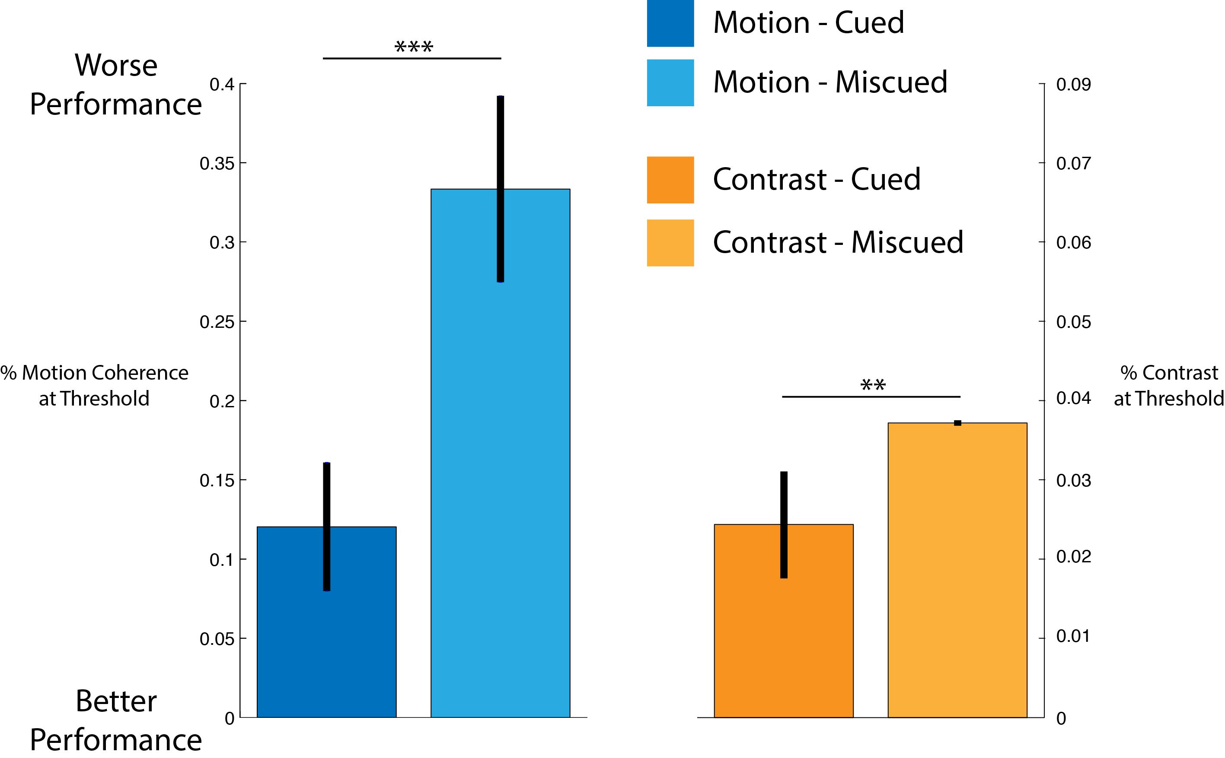

Slide 13
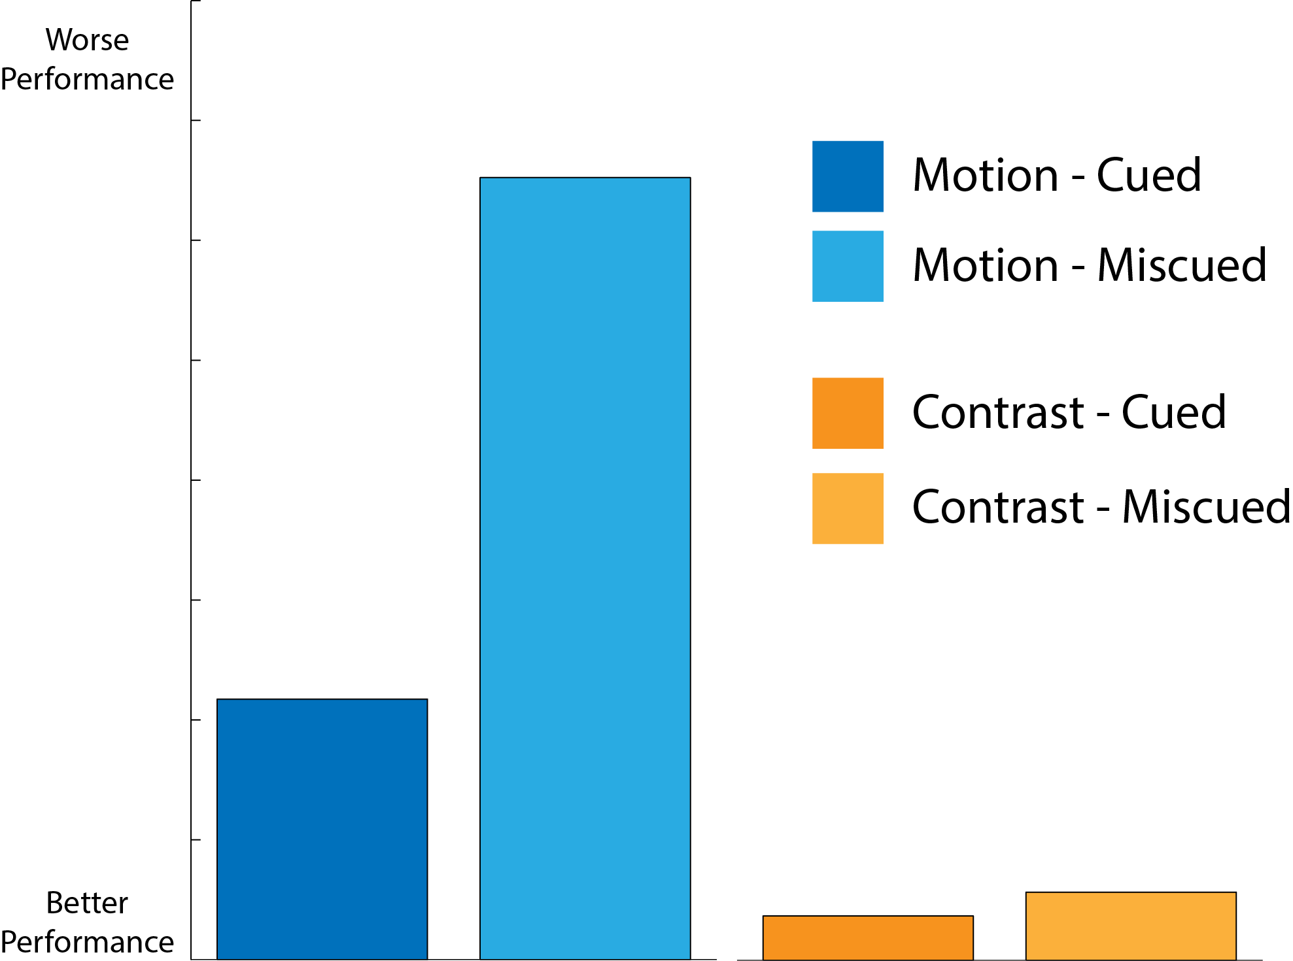
Stimulus Strength
Stimulus Strength

Slide 14
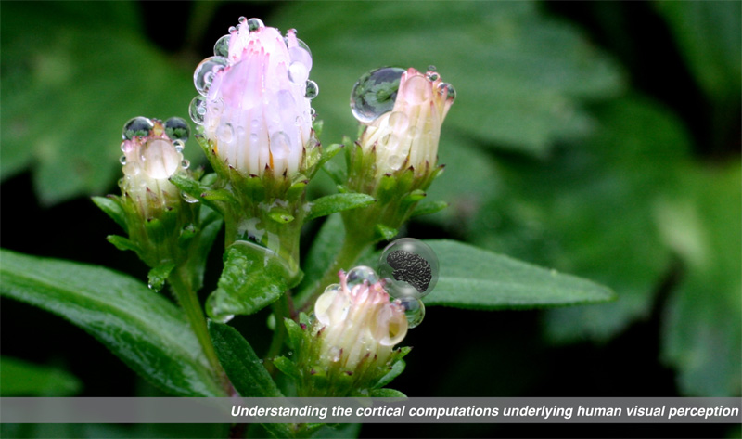

Gardner Lab @ Stanford University
Justin Gardner

